Slide 1
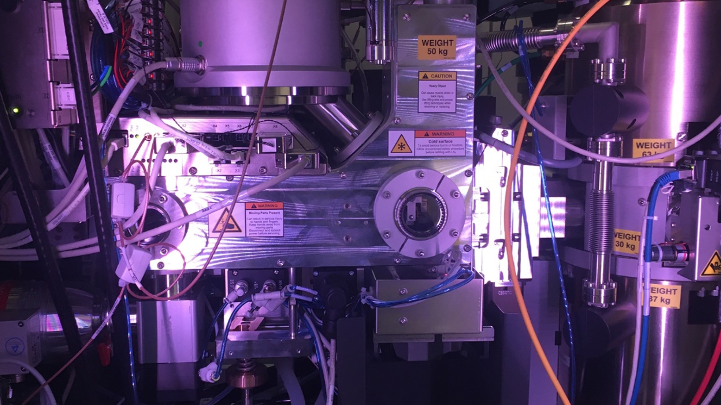
College of Natural Science Annual Meeting
^{November 18, 2022}

Slide 2
Annual Meeting and Awards Ceremony
STEM Teaching and Learning Facility, Rm. 2130
AGENDA
Friday, November 18, 2022
3:00 p.m. Annual meeting
Items:
Approval of Agenda for November 18, 2022
Approval of Minutes from November 19, 2021
State of the College—Phillip M. Duxbury
Other Business
  Bylaws updates
Awards Ceremony
(Reception immediately following)

Slide 3
College of Natural Science
NatSci Annual Meeting/Awards Ceremony
Meeting Minutes
November 19, 2021
Items of Business:
Approval of Minutes:
  The minutes of the Nov. 18, 2020, meeting were approved as distributed.
State of the College
  Dean Duxbury presented the State-of-the-College address.
Awards Ceremony:
The NatSci Awards Ceremony followed the annual meeting.
Award recipients were presented certificates acknowledging their award.
The meeting was adjourned at 4:00 pm.

Slide 4
Advancement Update
  FY 21/22 - Raised $8,060,384
    Exceeded $6.5M goal!
    The ongoing pandemic continued to make engaging with alumni challenging but the advancement team did start traveling more this fiscal year which helped close some lingering gifts.
  Created 9 new endowments, including:
    6 supporting student success
    1 new endowed faculty position

Slide 5
Advancement Update (con’t.)
  Current Priorities:
  1. Continue to fundraise for Student Success
      Undergraduate Scholarships
      Graduate Fellowships
      Undergraduate Research
      Dean’s Research Scholars Program

Slide 6
Advancement Update (con’t.)
  2. Continue to fundraise for faculty support:
      Endowed Professorships
      Endowed Chairs
      Research
  3. Continue to work toward developing a new comprehensive stewardship plan for the college and with the individual departments.
  4. Explore philanthropic opportunities and develop a fundraising plan around collaborative interdisciplinary research themes.

Slide 7
Advancement Engagement
  Goal is to continue to connect and engage in a meaningful way with NatSci’s 63,000 alumni via:
  NatSci/MSU Connect
  Regional Green and White events hosted by University Advancement
  Alumni events have been hybrid when appropriate:
    Dean’s Board of Advisor Meetings (October 2021 and April 2022)
    Classes without Quizzes (April 2022)

Slide 8
MSU/NatSci Enrollment
Fall 2022
MSU overall – 50,023 students (39,021 undergrad)
NatSci Fall 2022 undergraduate majors 5,737
NatSci Fall 2022 incoming freshmen 1,372
NatSci Fall 2021 graduate students 1,027
(889 Ph.D. students, 138 M.S. students)

Slide 9
College of Natural Science (FY22)
General fund allocation: $82M ($1,486M): 5.5%
Tenure stream faculty FTE: 273 (1,925): 14.2%
Tuition dollars generated: $195M ($1,010M): 19.3%
IDC from Grants: $19.9M ($104M): 18.6%
Federal Grant Income: $58.7M ($469M): 12.5%
Endowment: $111.5M
From an ROI perspective, NatSci is a top performer at MSU!

Slide 10
NatSci 2022-23 Budget
Recurring Budget: $73.5M – up 1.9%
$ n/a Salary increases provided after budget for FY23
$ n/a 1% program efficiency reduction ended in FY22
$ n/a No % base budget reduction for FY23
$ 1.4M University allocation (new funding)
($0.1m program support and $1.3m position support)
Non-Recurring Budget: $11.1M – up 16.8%
$ 2.7M Program allocations (enrollment pressure, spousal salaries, retention support)
$ 4.3M Off-campus & online instruction (no change)
$1.7M lost due to “revenue freeze”
$ 4.1M F&A (up $0.1M)

Slide 11
F&A Generated
13/14 through 21/22

Slide 12
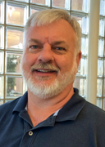
Department Leadership
Changes
  Tim Zacharewski
  Interim Chair
  Department Biochemistry and Molecular Biology

Slide 13
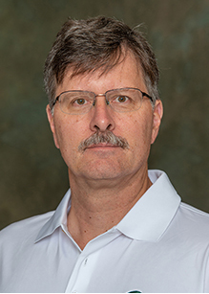
Department Leadership
Changes
  Jeff Freymueller
  Chair
  Department of Earth and Environmental Sciences

Slide 14
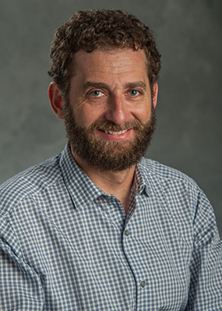
Department Leadership
Changes
  Jeff Schenker
  Chair
  Department of Mathematics

Slide 15
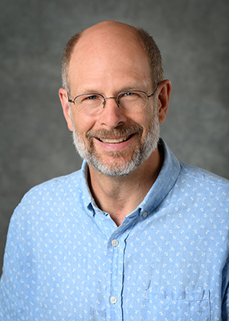
Department Leadership
Changes
  Karl Olson
  Interim Chair
  Department of Physiology

Slide 16
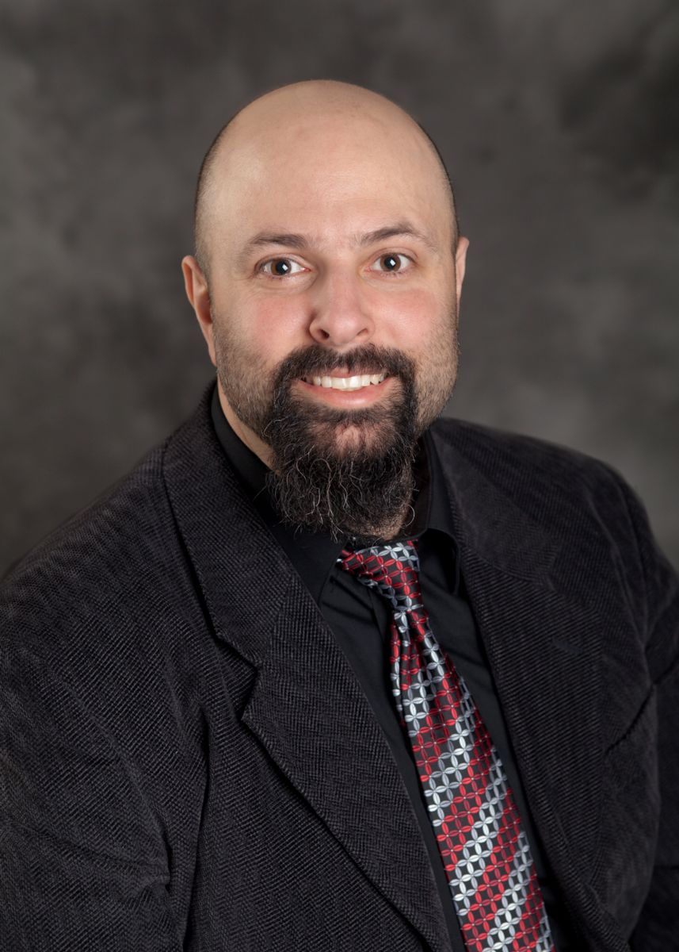
Program Leadership
Changes
  Albert Cohen
  Director
  Actuarial Science Program

Slide 17
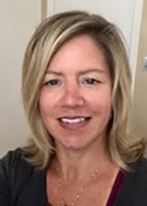
Program Leadership
Changes
  Beth Herbel-Eisenmann
  Director
  Program in Mathematics Education

Slide 18
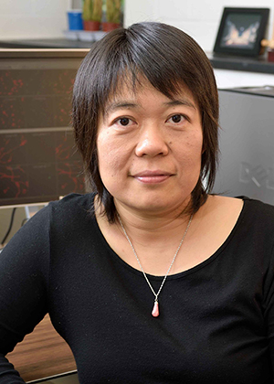
Program Leadership
Changes
  Jianping Hu
  Director
  Molecular Plant Sciences

Slide 19
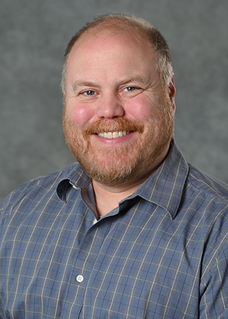
Program Leadership
Changes
  A.J. Robison
  Director
  Neuroscience Program

Slide 20
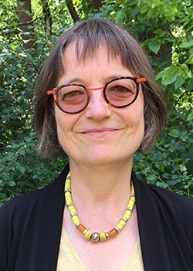
Program Leadership
Changes
  Claire Vieille
  Director
  Genetics and Genome Sciences

Slide 21
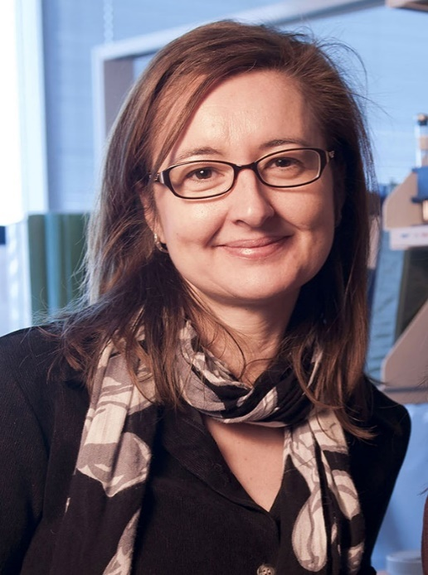
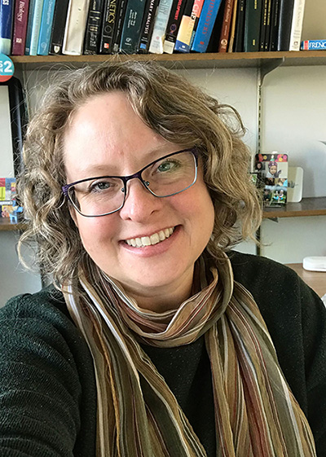
Leadership Changes NatSci Dean’s Office
Amy Ralston Associate Dean, Graduate Studies
Gemma Reguera Associate Dean,
Faculty Affairs and Development

Slide 22
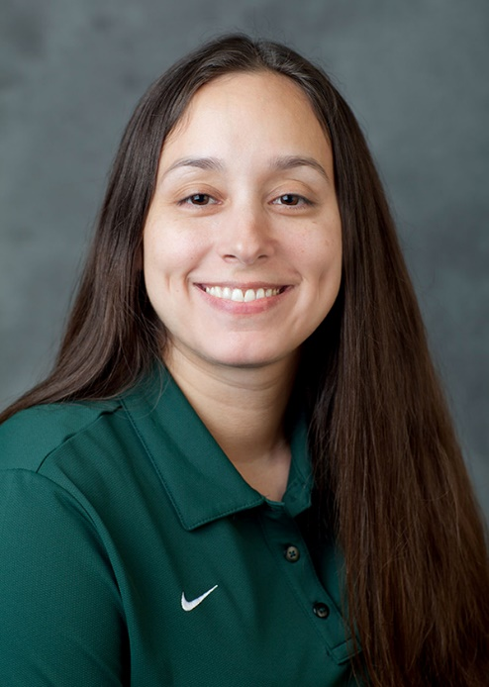
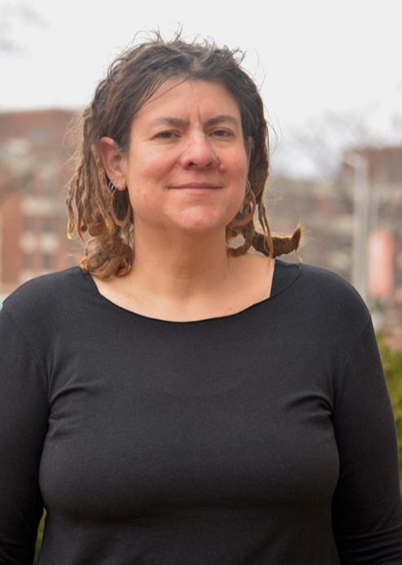
Leadership Changes NatSci Dean’s Office
Heather Eisthen Faculty Excellence Advocate
Danielle Flores Lopez
Interim DEI Assistant Dean

Slide 23
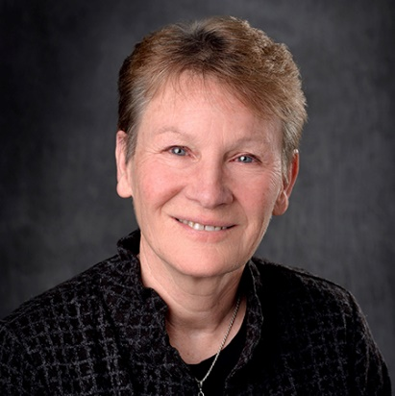
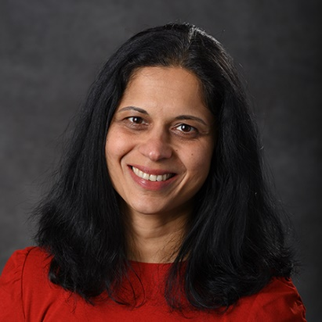
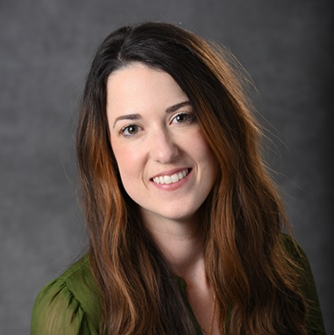
NatSci Dean’s Office Promotions
Val Osowski
Senior Communications and Marketing Director
Kaitlin Peterson
Assistant Director of Pre-Health & Human Biology
Kanchan Pavangadkar
Assistant Director,
Student Success

Slide 24
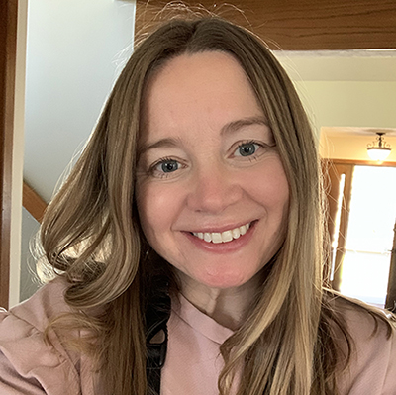
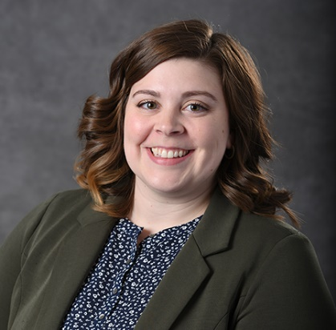
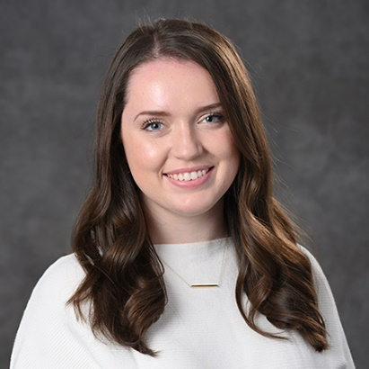
New Staff in NatSci Dean’s Office
Lisa Backus
Research Administrative
Assistant, Office of Research Support
Holly Wright
Human Biology and Pre-Health Advisor
Raychel Meyer-Payne
Human Biology and Pre-Health Advisor

Slide 25
NatSci Faculty & Academic Staff (31)
Biological Sciences Program
Sara Garnett, Instructor-Fixed Term
Jenn Kirk, Instructor-Fixed Term
Kevin McCormick, Instructor-Fixed Term
Chemistry
Steven Hurney, Specialist-Teaching
Elizabeth McGaw, Specialist-Teaching
Tian (Autumn) Qiu, Assistant Professor
Tuo Wang, Associate Professor
Weiwei Xie, Associate Professor

Slide 26
NatSci Faculty and Academic Staff (cont.)
Computational Mathematics, Science and Engineering
Longxiu Huang, Assistant Professor
Kevin Miloshoff, Specialist-Advisor
Earth & Environmental Sciences
Anthony Kendall, Assistant Professor
Integrative Biology
James Moran, Associate Professor
Kellogg Biological Station
Alisha Shah, Assistant Professor

Slide 27
NatSci Faculty and Academic Staff (cont.)
Mathematics
Kevin Lawrence, Instructor-Fixed Term
Konstantin Matetski, Assistant Professor
Michail Paparizos, Instructor-Fixed Term
Microbiology & Molecular Genetics
Andrew Crawford, Specialist-Research
Yu Zhang, Assistant Professor
Physics & Astronomy
Kerim Gulyuz, Assistant Professor Fixed Term
Kirtimaan Mohan, Assistant Professor, Lyman Briggs

Slide 28
NatSci Faculty and Academic Staff (cont.)
Physiology
Byron Gipson, Assistant Professor Fixed Term
Cameron Prigge, Assistant Professor Fixed Term
Theodore Towse, Associate Professor Fixed Term
Charlotte Vanacker, Assistant Professor Fixed Term
Jennifer Doherty, Assistant Professor Lyman Briggs
Shahnaz Masani, Assistant Professor Lyman Briggs
Plant Biology
Lauren Sullivan, Assistant Professor

Slide 29
NatSci Faculty and Academic Staff (cont.)
Plant Research Laboratory
Stefan Schmollinger, Assistant Professor Research-Fixed Term
Daniela Strenkert, Assistant Professor
Program in Mathematics Education
Kristen Vroom, Assistant Professor Lyman Briggs
Statistics and Probability
Hyokyoung Hong, Associate Professor Fixed Term

Slide 30

2022 Faculty Honors

Slide 31
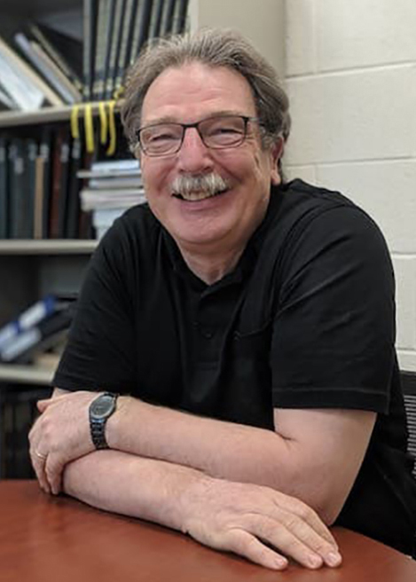
National Academy of Inventors, Senior Member
Christoph Benning
Director, MSU-DOE Plant Research Laboratory
University Distinguished Professor
MSU Foundation Professor
Biochemistry & Molecular Biology/Plant Biology
Benning, internationally known for his research on plant lipid metabolism, was one of only 83 academic inventors elected to this group in 2022.

Slide 32
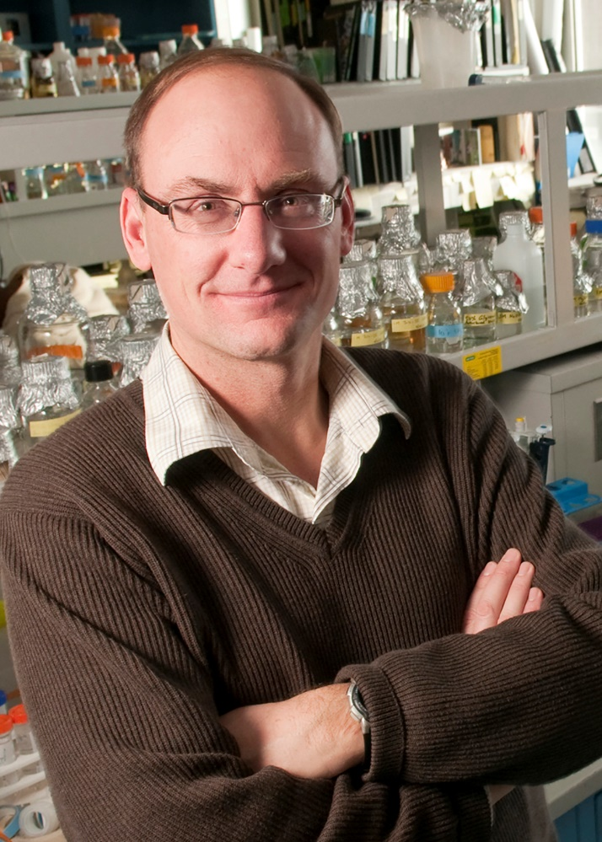
U.S. Fulbright Scholar (2022-23)
Gregg Howe
University Distinguished Professor
MSU Foundation Professor
Biochemistry & Molecular Biology
Howe, internationally known for his work on plant resilience and how plants respond to insect attacks, will head to Japan to apply cutting-edge genetic technologies to the development of crop plants that will contribute to sustainable agriculture and food security.

Slide 33
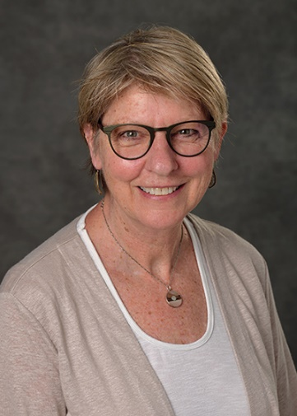
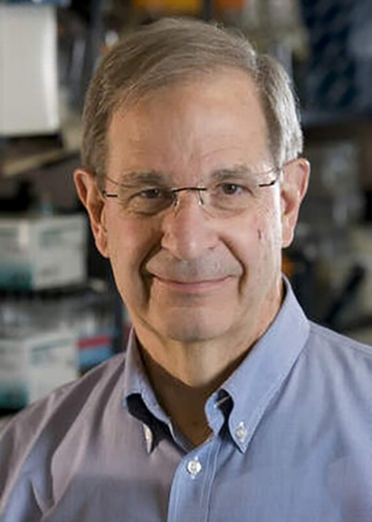
2022 Lifetime Achievement Awards
Cheryl Sisk
Professor, Neuroscience and Psychology
Daniel S. Lehrman Lifetime Achievement Award, Society for Behavioral Neuroendocrinology
James Tiedje
Professor Emeritus,
Microbiology & Molecular Genetics
Lifetime Achievement Award, American Society of Microbiology

Slide 34
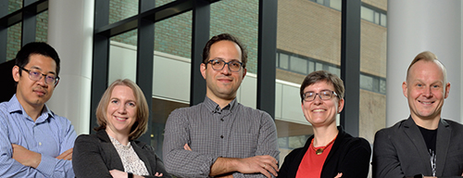

2022 NSF Early CAREER Award Winners
(L to R): Huan Lei (CMSE, Statistics & Probability), Elizabeth Munch (CMSE, Mathematics), Mohammad Maghrebi (Physics & Astronomy), Julia Ganz (Integrative Biology), and Johannes Pollanen (Physics & Astronomy), received 2022 NSF Early CAREER Awards. Collectively, over the next 5 years, they will receive more than $3.7 million in NSF funding.
There are currently 24 Early CAREER grants in effect in NatSci!

Slide 35
Foundation/Agency/Organization Awards
North American Cohort, Earth Leadership Program
  Sarah Evans, Microbiology & Molecular Genetics/KBS
Alfred P. Sloan Fellowship
  Dalton Hardisty, Earth & Environmental Sciences
  Ilya Kachkovskiy, Mathematics
Iota Sigma Pi – National Honorary Member
  Angela K. Wilson, Chemistry
Organization of Biological Field Stations – Advancing Equity Award
  Kellogg Biological Station

Slide 36
Professional Society Awards
American Chemical Society – Ahmed Zewail Award
  Marcos Dantus, Chemistry/Physics & Astronomy
American Physical Society Fellowship
  Danny Caballero, Physics & Astronomy
  Huey-Wen Lin, Mathematics/CMSE
American Physical Society – Excellence in Education Award
  Danny Caballero, Physics & Astronomy
American Physical Society – Award for Improving Undergrad Physics Education
  Department of Physics & Astronomy

Slide 37
Professional Society Awards
American Society for Plant Biologists Awards
  ASPB Fellows: Erich Grotewold, Biochemistry & Molecular Biology;
and Jiming Jiang, Plant Biology
  Early Career Award: Emily Josephs, Plant Biology
  Robert Rabson Award: Berkley Walker, Plant Biology/PRL
American Statistical Association Fellowship
  Yuehua Cui, Statistics and Probability
Society for Industrial and Applied Mathematics
  Keith Promislow, Mathematics

Slide 38
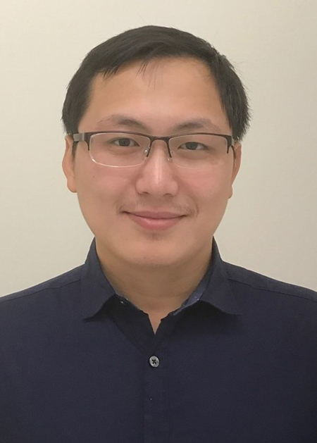
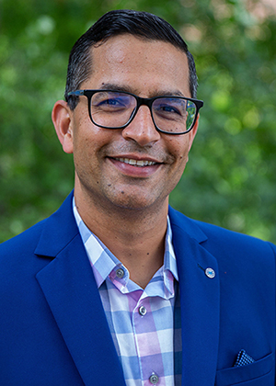
Endowed NatSci Faculty
Carl H. Brubaker, Jr. Professor
Tuo Wang
Chemistry
Lappan-Phillips Professor of Computing Education
Aman Yadav
CMSE

Slide 39
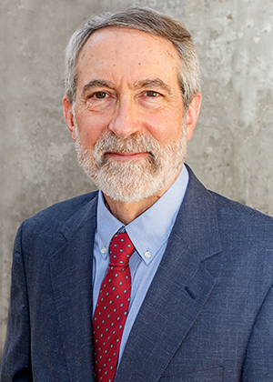
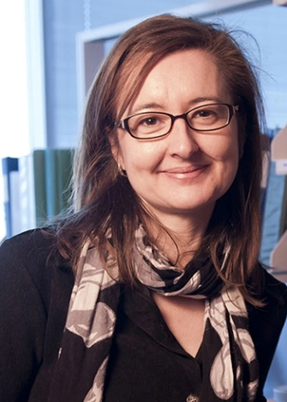
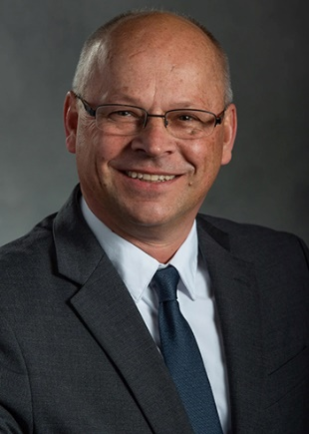
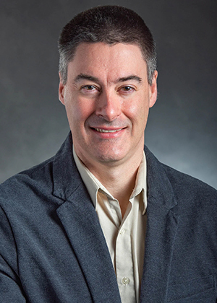
William J. Beal Outstanding Faculty Awards
Jeffrey Conner
Plant Biology
Gemma Reguera
Microbiology & Molecular Genetics
Jetze Tepe
Chemistry
Christopher Waters
Microbiology & Molecular Genetics

Slide 40
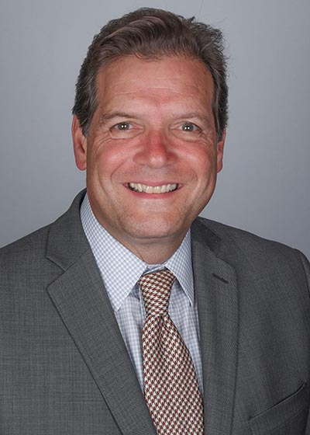
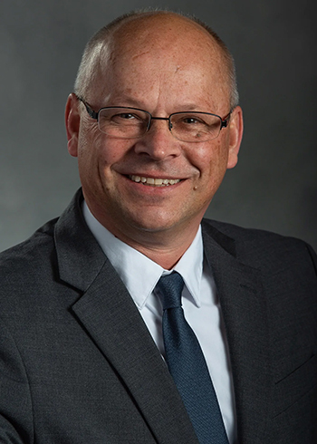
Other Universitywide Honors
Victor DiRita
Rudolph Hugh Professor
Microbiology & Molecular Genetics
Simmons Chivukula Award for Academic Leadership
Jetze Tepe
Chemistry
Innovator of the Year,
MSU Innovation Center

Slide 41
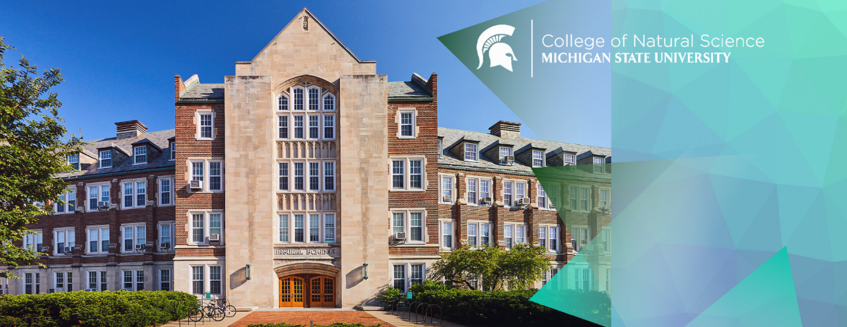
Recent Grants

Slide 42
Some Recent Grants
DOE
Mathematical Multifaceted Integrated Capability Center (MMICC) grant (CHaRMNET) PI: Andrew Christlieb, CMSE, Mathematics, $15 million (2022-2027)
The Center for Catalysis in Biomimetic Confinement (Energy Frontier Research Center) PI: Cheryl Kerfeld, Biochemistry & Molecular Biology/PRL, $10.65 million (2022-2026)
A systems framework to enhance the potential of camelina as oilseed crop PI: Erich Grotewold, Biochemistry
& Molecular Biology, $2.07 million (2022-2025)
NIH
Revealing pathways and kinetics of molecular recognition with advanced molecular simulation algorithms
PI: Alex Dickson, Biochemistry & Molecular Biology, $1.32 million (2022-2026)
Folding and degradation of membrane proteins (NIGMS) PI: Heedoek Hong, Chemistry, $1.54 million, (2022-2027)

Slide 43
Recent Grants
NIH (con’t.)
Examining PHGDH-mediated activation of sialic acid metabolism to drive triple-negative breast cancer metastisis (RO1) PI: Sophia Lunt, Biochemistry & Molecular Biology, $2.02 million (2022-2027)
Structural basis of antimicrobial peptide sensing and resistance PI: Ben Orlando, Biochemistry & Molecular Biology, $1.87 million (2022-2027)
Understanding the role of testosterone in how males and females experience depression PI: A.J. Robison, Physiology/Neuroscience, $3 million (2022-2026)
AI-based platform for predicting emerging vaccine-escape variants and designing mutation-proof antibodies (NIH RO1) PI: Guowei Wei, Mathematics, $2.7 million (2022-2027)
NSF
Harnessing the data revolution to enable predictive multi-scale modeling across STEM PI: Daniel Appelo, CMSE, Mathematics $3 million (2022-2027)

Slide 44
Recent Grants
NSF (cont.)
Lipid derived signaling involving chloroplasts (RC1) PI: Christoph Benning, PRL/Biochemistry & Molecular Biology, $1.07 million (2022-2026)
U.S. Atlas Operations: Discovery and Measurement at the Energy Frontier PI: Wade Fisher, Physics & Astronomy, $3 million (2022-2027)
Evaluating Effects of automatic feedback aligned to a learning progression to promote knowledge-in-use PI: Kevin Haudek, CREATE for STEM, $2.04 million, (2022-2026)
Atlas Great Lakes Tier-2 Center (AGL-T2) PI: Daniel Hayden (MSU), Physics & Astronomy, $1.86 million (2022-2027)
Algebraic and Geometric Topology at Michigan State (RTG) PI: Matt Hedden, Mathematics, $1.93 million
(2022-2027)

Slide 45
Recent Grants
NSF (con’t.)
Collaborative Research: Frameworks: Interoperable high-performance classical, machine learning and quantum free energy methods in AMBER PI: Kenneth Merz, Chemistry, $2.66 million (2022-2026)
Using problem-based learning analytics to investigate individual and collaborative mathematics learning in a digital environment over time PI: Elizabeth Phillips, PRIME, $1.62 million (2022-2026)
W.M. Keck Foundation, Science and Engineering Program
Gradient Reconstruction Imaging: Achieving diffraction-less imaging on living systems Pis: Marcos Dantus, Elad Harel, Chemistry, $1.3 million (2022-2025)

Slide 46
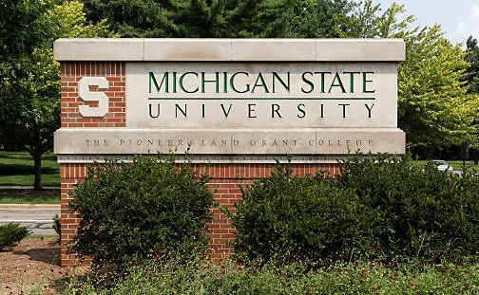
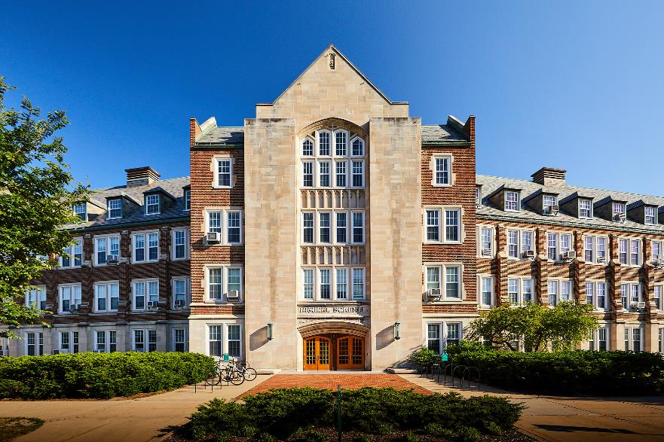
NatSci Strategic Priorities and Initiatives
Implementing the Strategic Plan: Some Metrics

Slide 47
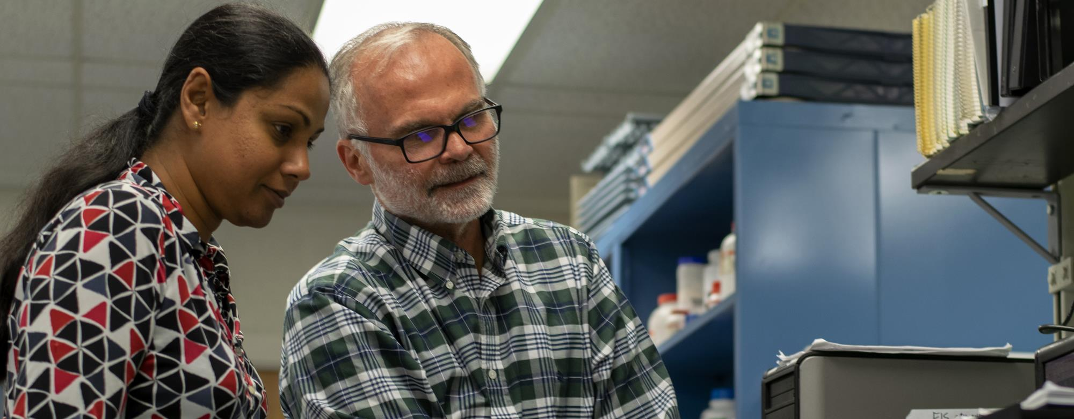
Graduate Training Program Grants
AY22 Baseline: 7, Current: 9, AY27 metric: 14

Slide 48
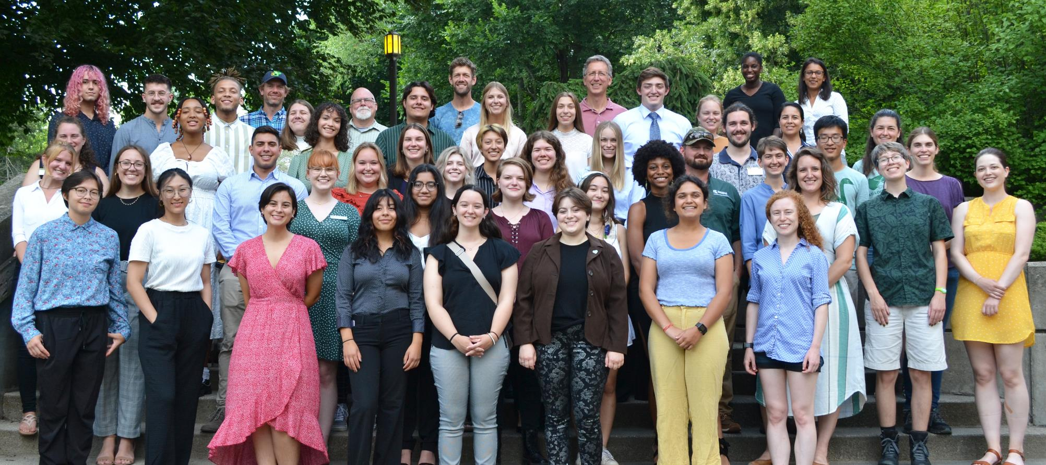
Diversity Hiring Processes
Leadership; TS faculty; NatSci community

Slide 49
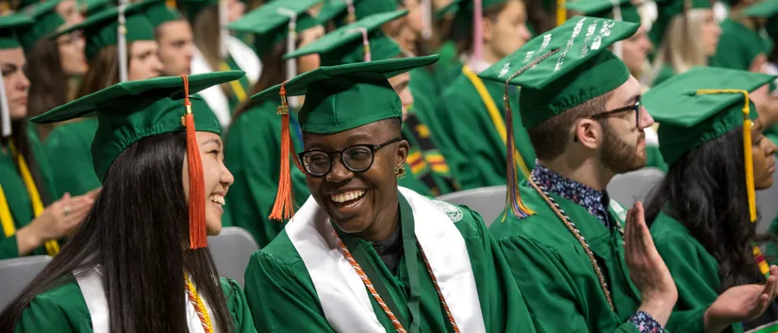
Student Success
Reduce DFW rates, increase learning, expand career options

Slide 50
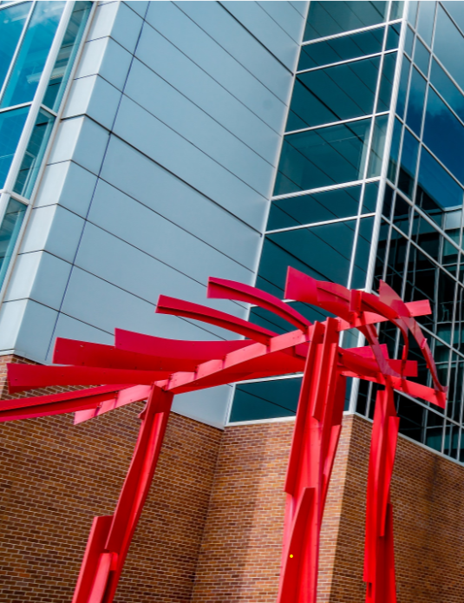
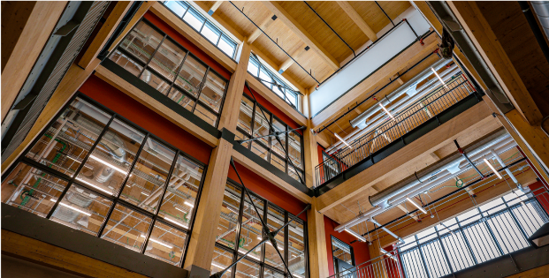
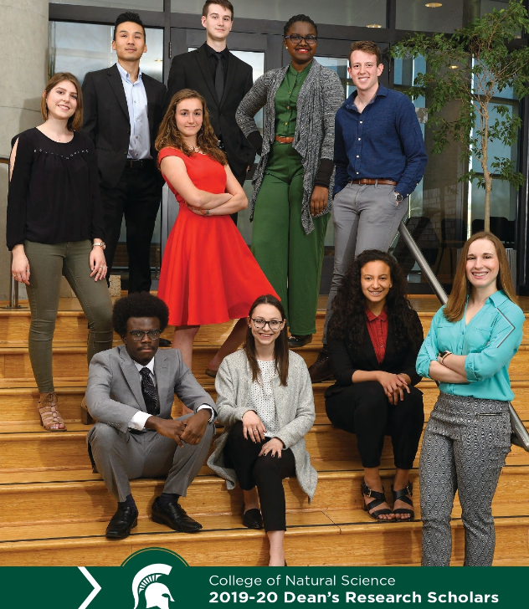

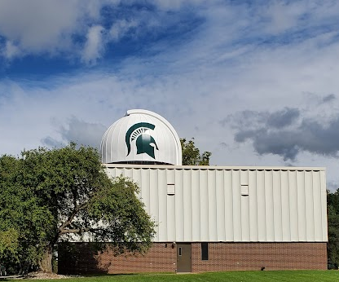
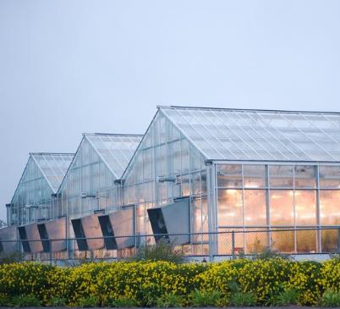
Cross-College Themes
Climate, Environmental Sciences, Plant Sciences
Data Science, AI, Quantum Computing, Cybersecurity, Gaming
Biomedical and One Health Scholarship
Chemical, Mathematical and Physical Sciences
STEM Education Research

Slide 51

^{THANK YOU!}

Slide 52
College of
Natural Science
Awards
2022-23

Slide 53
NatSci Outstanding Faculty Award
2022-2023
These awards go primarily to senior faculty members in recognition of outstanding contributions in scholarly research and teaching to the college and the university.

Slide 54
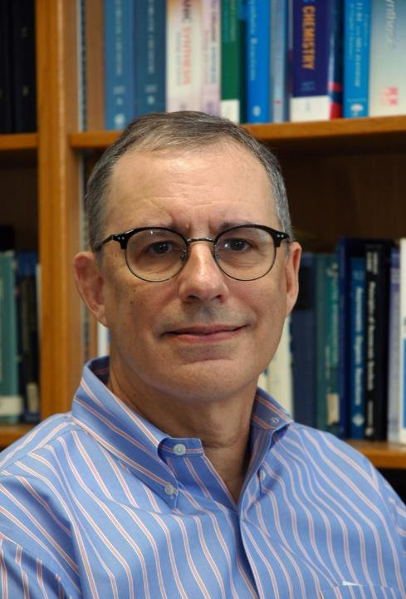

NatSci Outstanding
Faculty Award
2022-2023
Robert Maleczka
Chemistry

Slide 55
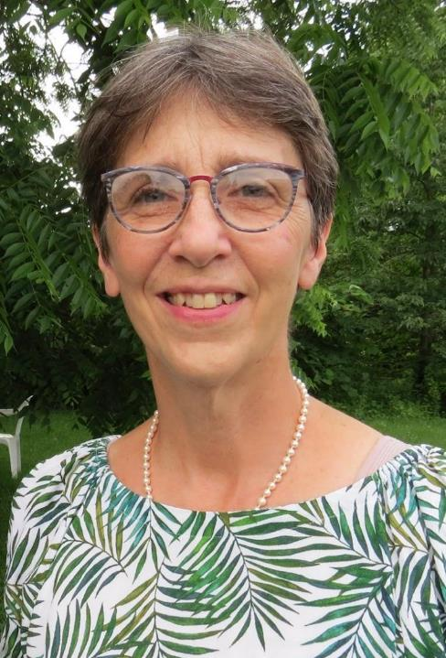
NatSci Outstanding
Faculty Award
2022-2023
Frances Trail
Plant Biology

Slide 56
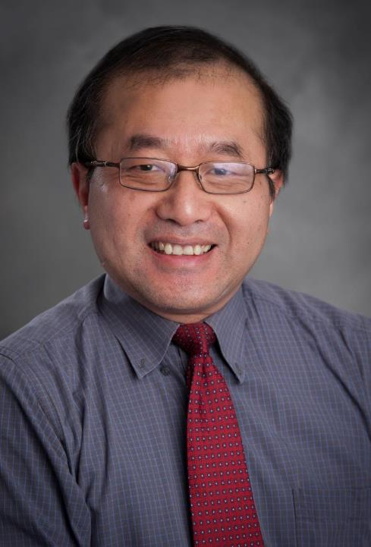
NatSci Outstanding
Faculty Award
2022-2023
Jie Wei
Physics & Astronomy/FRIB

Slide 57
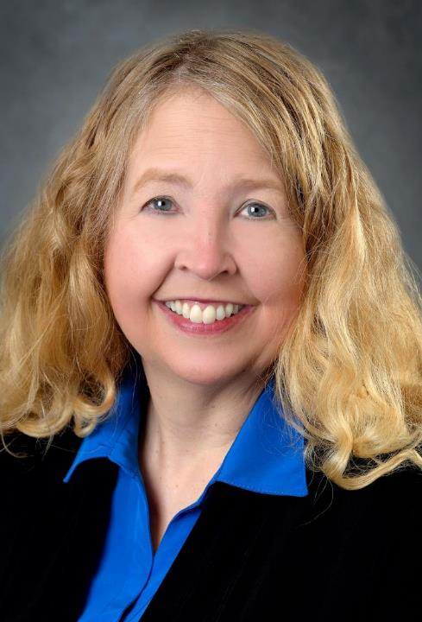
NatSci Outstanding
Faculty Award
2022-2023
  Angela Wilson
  Chemistry/Dean's Office

Slide 58
NatSci Research Leadership Award
2022-2023
Research Leadership Awards are given each year to recognize NatSci tenured full professors for outstanding, impactful research and internationally recognized leadership in the field.

Slide 59
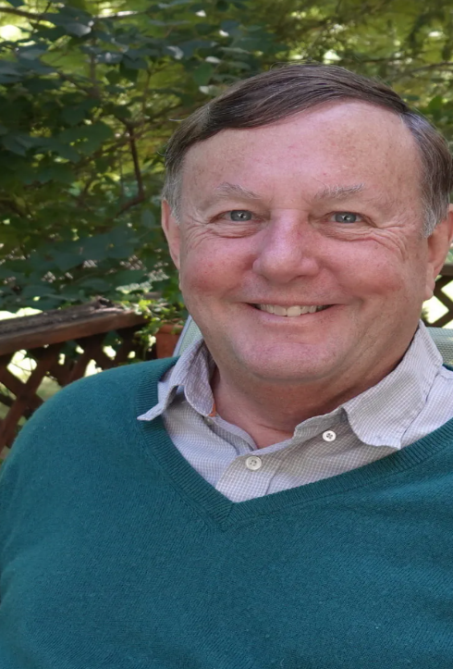
Research Leadership
Award
2022-2023
  B. Alex Brown
  Physics & Astronomy

Slide 60
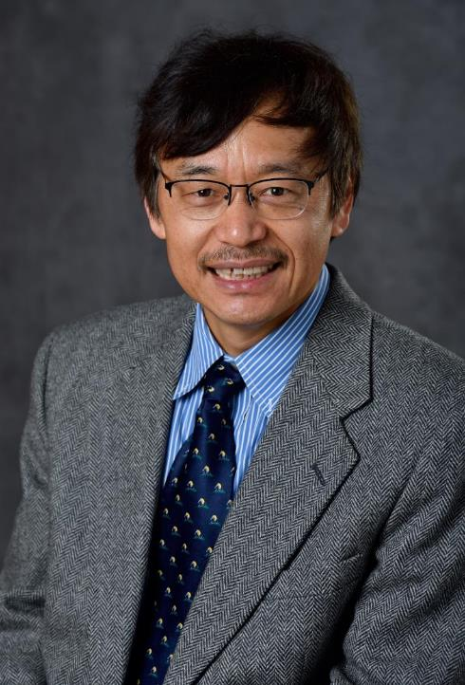
Research Leadership
Award
2022-2023
  Jiming Jiang
  Plant Biology

Slide 61
2022-23 Mid-Career Award Winner
Mid-Career Research Awards are given each year to
recognize NatSci tenured faculty for outstanding
research. The award is based on success and impact of
publications, funding, and other criteria that
demonstrate excellence in the awardee’s field

Slide 62

Mid-Career Research
Award
2022-2023
  Shannon Manning
  Microbiology & Molecular Genetics

Slide 63

Mid-Career Research
Award
2022-2023
  Shinhan Shiu
  Plant Biology

Slide 64
2022-23 Early Career Research Award
Early Career Research Awards are given each year to
recognize NatSci tenure-track faculty for outstanding
research. The award is based on success in publications,
funding, and other criteria that signify excellence

Slide 65

Early Career Research Award
2022-2023
  Kendall Mahn
  Physics & Astronomy

Slide 66

Early Career Research Award
2022-2023
  Phoebe Zarnetske
  Integrative Biology

Slide 67
NatSci Teacher-Scholar Award
2022-2023
These awards go to assistant and associate professors for their outstanding contributions to teaching and scholarly research.

Slide 68

NatSci Teacher-Scholar
Award
2022-2023
  Sophia Lunt
  Biochemistry & Molecular Biology

Slide 69

NatSci Teacher-Scholar
Award
2022-2023
  Brent Nelson
  Mathematics

Slide 70
NatSci Undergraduate Teaching Award
2022-2023
These awards go to faculty members who have demonstrated outstanding contributions to, and continuing involvement in, creative and engaging ways to foster student learning and instruction.

Slide 71

NatSci Undergraduate Teaching Award
2022-2023
  Kevin Haudek
  Biochemistry & Molecular Biology

Slide 72

NatSci Undergraduate Teaching Award
2022-2023
  Jaideep Singh
  Physics & Astronomy/FRIB

Slide 73
NatSci Junior Faculty Mentoring Award
2022-2023
This award goes to faculty members who have made outstanding contributions to mentoring junior faculty members throughout their academic career.

Slide 74

NatSci Junior Faculty Mentoring Award
2022-2023
  Amy Ralston
  Biochemistry & Molecular Biology/Dean’s Office

Slide 75
NatSci Postdoctoral Mentoring Award
2022-2023
This award goes to faculty members who have made outstanding contributions to the effective mentoring of postdoctoral researchers in both professional development and holistic balance.

Slide 76

NatSci Postdoctoral Mentoring Award
2022-2023
  Diane Ebert-May
  Plant Biology

Slide 77
NatSci Distinguished Academic
Staff Award 2022-2023
This award goes to academic staff members for outstanding contributions to improving the success of students in the college.

Slide 78

NatSci Distinguished Academic Staff Award
2022-2023
  Kathryn Severin
  Chemistry

Slide 79
Undergraduate Academic Advisor
Award 2022-2023
This award goes to faculty members or academic staff for their outstanding service as advisors. It is awarded by the NatSci Student Advisory Council.

Slide 80

Undergraduate Academic Advisor Award
2022-2023
  Sheba Onchiri
  Chemistry

Slide 81
Graduate Academic Advisor Award
2021-2022
This award goes to faculty members or academic staff for their outstanding commitment and dedication to student success. It is awarded by the NatSci Student Advisory Council.

Slide 82

Graduate Academic Advisor Award
2022-2023
  Remco Zegers
  Physics & Astronomy

Slide 83
NatSci Support Staff Award
2022-2023
These awards go to staff members who have exceptional job performance and contributions that have improved the university’s ability to fulfill its missions.

Slide 84

NatSci Support Staff Award
2022-2023
  Julie Pozega
  Center for Integrative Studies in General Science

Slide 85

NatSci Support Staff Award
2022-2023
  Tiphani Scott
  Chemistry

Slide 86
NatSci Excellence-in-Teaching Citation
2022-2023
These awards go to instructors and teaching assistants who have distinguished themselves in undergraduate classroom teaching.

Slide 87

NatSci Excellence-in-Teaching Citation
2022-2023
  S. Kevin McCormick
  Integrative Biology/BioSci

Slide 88

NatSci Excellence-in-Teaching Citation
2022-2023
  Joseph Riedy
  Integrative Biology

Slide 89
NatSci Undergraduate Learning Assistant Award 2022-2023
This award is given in recognition of the care given and the skill shown in meeting classroom responsibilities in the College of Natural Science.

Slide 90

NatSci Undergraduate Learning Assistant Award
2022-2023
  Ava Bassett
  Neuroscience

Slide 91

NatSci Undergraduate Learning Assistant Award
2022-2023
  Christina Liu
  Integrative Biology

Slide 92
NatSci Faculty Teaching Prize
2022-2023
NatSci Faculty Teaching Prizes are made to fixed term and tenure system faculty in recognition of excellent teaching. Nominations are made by department chairs during the annual faculty raise process.

Slide 93

NatSci Faculty Teaching Prize
2022-2023
  Michael Brown
  Mathematics

Slide 94

NatSci Faculty Teaching Prize
2022-2023
  Corrine Higley
  Biological Science Program

Slide 95

NatSci Faculty Teaching Prize
2022-2023
  Krystyna Kijewska
  Chemistry

Slide 96

NatSci Faculty Teaching Prize
2022-2023
  Dola Pathak
  Statistics and Probability

Slide 97
^{CISGS Awards}
²⁰²²⁻²⁰²³
The next four awards are given by the college’s Center for Integrative Studies in General Science:

Slide 98
Lorena V. Blinn Endowed
Teaching Award
2022-2023
This award goes to faculty members who exhibit expertise in teaching and in advancing pedagogy and the education offered by CISGS.

Slide 99

Lorena V. Blinn Endowed Teaching Award
2022-2023
  Matt Oney
  Center for Integrative Studies in Science

Slide 100
James D. Hoeschele Endowed
Teaching Award
2022-2023
This award recognizes outstanding teaching in integrative studies.

Slide 101

James D. Hoeschele Endowed Teaching Award
2022-2023
  Scott Winterstein
  Department of Fisheries and Wildlife

Slide 102
Ronald W. Wilson Endowed
Teaching Award
2022-2023
This award goes to a faculty or staff member for outstanding contributions to teaching and scholarship in integrative studies.

Slide 103

Ronald W. Wilson Endowed Teaching Award
2022-2023
  Rachael Lund
  Mathematics

Slide 104
Harlo Mervyn Mork Memorial
Excellence in Teaching Award
2022-2023
This award is given to teaching assistants in recognition of outstanding contributions to the improvement of undergrad education in integrative studies.

Slide 105

Harlo Mervyn Mork Memorial Excellence-in-Teaching Award
2022-2023
  Sierra Casten
  Physics & Astronomy

Slide 106

Harlo Mervyn Mork Memorial Excellence-in-Teaching Award
2022-2023
  Jack Schulte
  Physics & Astronomy

Slide 107
Norman L. and Olga K. Fritz
Excellence in Teaching Award
2022-2023
This award is open to teaching faculty of any rank, fixed term or tenure, and recipients are selected by the College of Natural Science award committee with student input. The Fritz Award was established to honor and encourage individuals who have exhibited excellence in teaching in the college, especially in physics and mathematics, at Michigan State University.

Slide 108

Norman L. and Olga K. Fritz
Excellence-in-Teaching Award
2022-2023
  Devin Silvia
  Computational Mathematics, Science and Engineering

Slide 109
^{THANK YOU!}

Slide 110
College of Natural Science Annual Meeting
^{November 18, 2022}

